Slide 1

Modeling IX

Slide 2
Introduction
Continue Model Selection Using Shrinkage Estimation Methods
Tutorial
Download Rmd
Knit the Document
Extended from Last Tutorial
We are Beginning in Part 2 Chunk 4
Do You Remember What We Learned? Let Me Remind You.

Slide 3
Irrelevant Nonsense
Watch Me Whip
Watch Me
Lasso

Slide 4
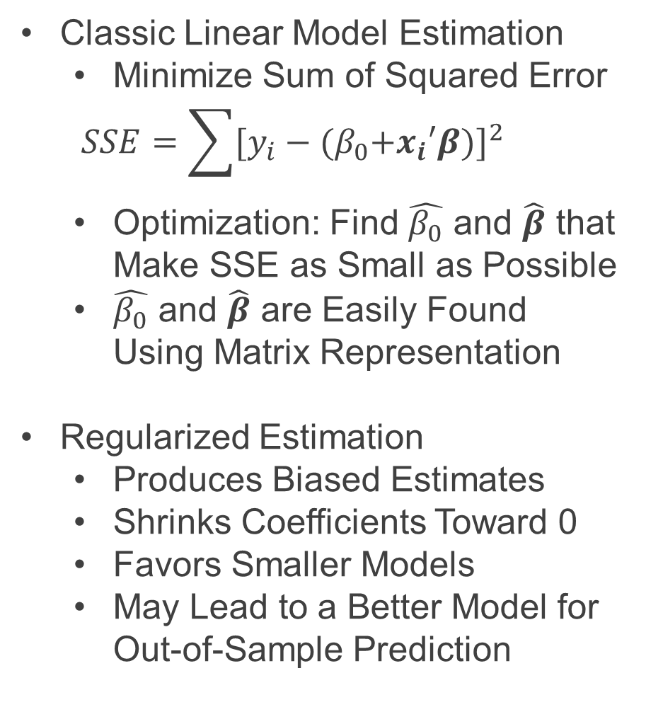
Recall Info
Classic Linear Model Estimation
Minimize Sum of Squared Error
$$SSE=\sum{[y_{i}−{{(β}_{0}+x_{i}′β)]}^{2}}$$
Optimization: Find $\hat{β_{0}}$ and $\hat{β}$ that Make SSE as Small as Possible
$\hat{β_{0}}$ and $\hat{β}$ are Easily Found Using Matrix Representation
Regularized Estimation
Produces Biased Estimates
Shrinks Coefficients Toward 0
Favors Smaller Models
May Lead to a Better Model for Out-of-Sample Prediction

Slide 5
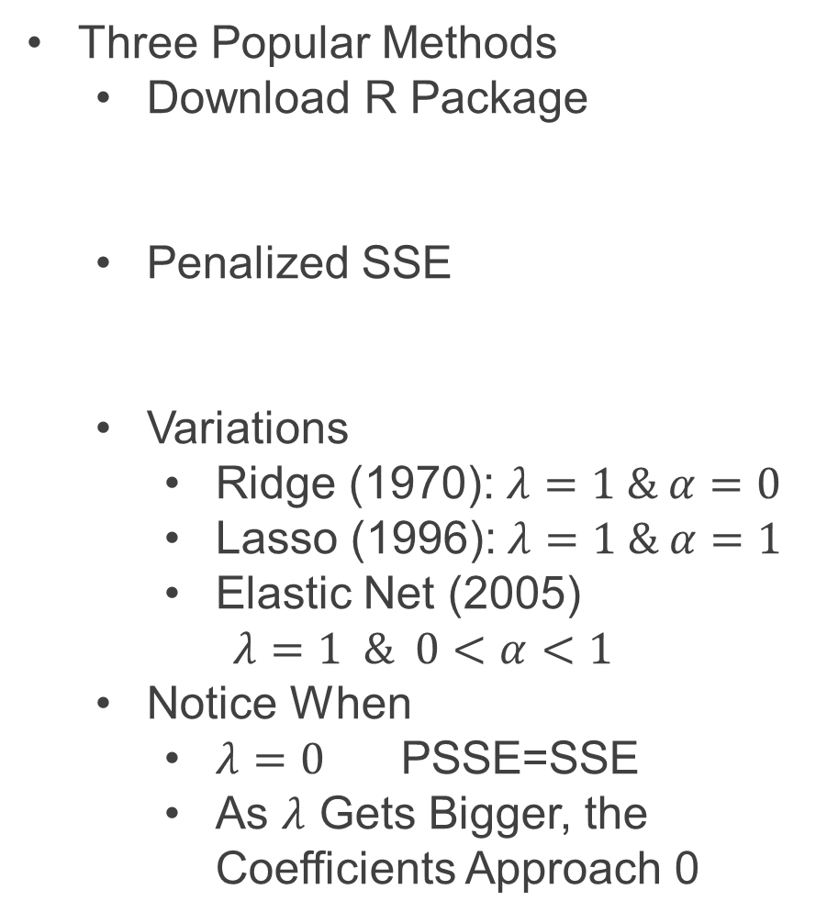

Recall Info
Three Popular Methods
Download R Package
Penalized SSE
Variations
Ridge (1970): $λ=1 \& α=0$
Lasso (1996):$λ=1 \& α=1$
Elastic Net (2005)
$$λ=1 \& 0<α<1$$
Notice When
$λ=0$ PSSE=SSE
As $λ$ Gets Bigger, the Coefficients Approach 0
> library(glmnet)
$$PSSE=SSE+λ[\left(1−α\right)\sum_{i=1}^{p}{β_{i}^{2}}+α\sum_{i=1}^{p}{\left|β_{i}\right|}]$$

Slide 6
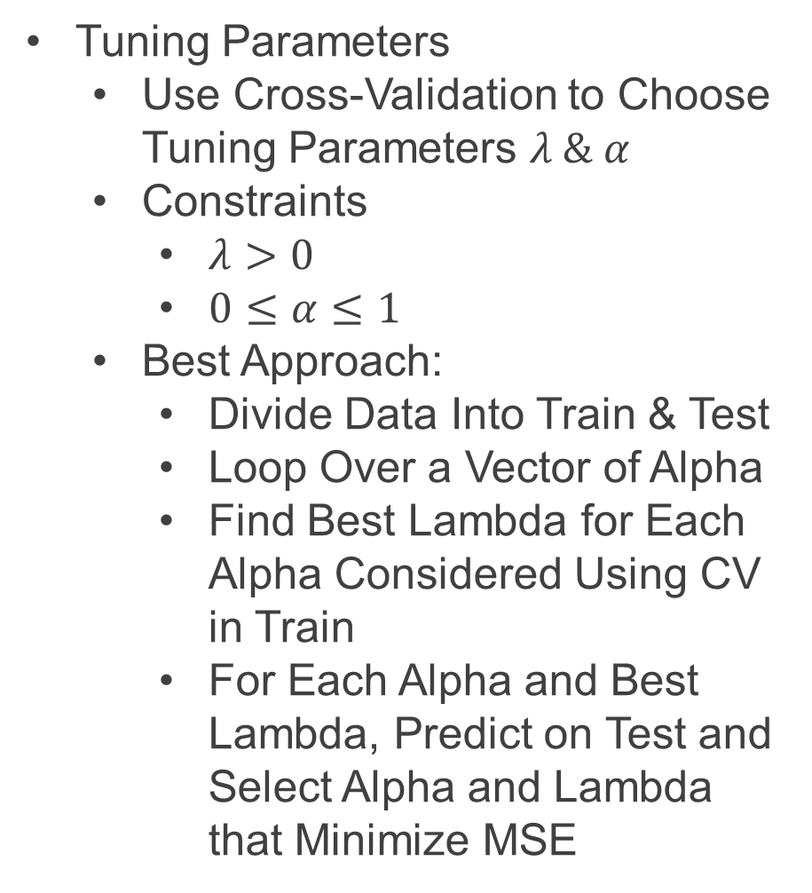
Next Steps
Tuning Parameters
Use Cross-Validation to Choose Tuning Parameters $λ \& α$
Constraints
$λ>0$
$0≤α≤1$
Best Approach:
Divide Data Into Train & Test
Loop Over a Vector of Alpha
Find Best Lambda for Each Alpha Considered Using CV in Train
For Each Alpha and Best Lambda, Predict on Test and Select Alpha and Lambda that Minimize MSE

Slide 7
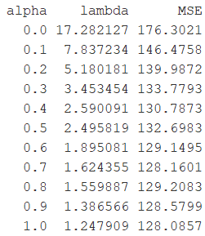

Part 2: Shrinkage Estimation and More Meditation
Run Chunk 4
Illustration of 10 Fold CV
Finding Best Combination of Alpha and Lambda
Best:$α=1 \& λ=1.25$

Slide 8
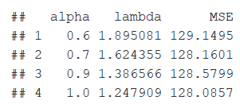
Part 2: Shrinkage Estimation and More Meditation
Run Chunk 5
The Top 4 Models
Question: How Different Are These Models?
For Each Alpha & Lambda,
Get Final Coefficients
Compare Across Models
Compare to True Values

Slide 9
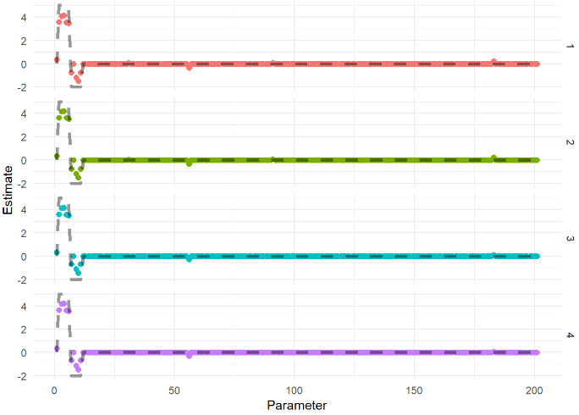
Part 2: Shrinkage Estimation and More Meditation
Chunk 5 (Continued)
Visualizing Top Four
Points Show Estimates
Dashed Line Shows Truth

Slide 10
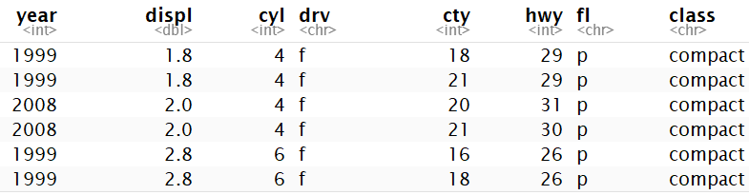
Part 3: Less Meditation and More Application
Built-In Data
n=234
Focus is on Modeling Hwy MPG
Subset Data to Include Only Wanted Covariates
There are p=7 Covariates
Difficulty
Fitting all Combinations
Considering All 2-Way Interaction Terms
> mpg

Slide 11
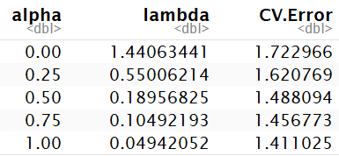
Part 3: Less Meditation and More Application
Run Chunk 1
Creating Model Matrix
Up to 2-Way Interactions
Now, p=115
Model Selection is Difficult
Dividing Data into Train & Test is Not Advised (n=234)
Run Chunk 2
Only a Few Options
Lowest Estimation of Prediction Error

Slide 12
Part 3: Less Meditation and More Application
Chunk 2 (Continued)
Understanding cv.glmnet Object
$lambda = Contains Vector of Lambda Auto-Generated
$cvm = Cross Validated Estimate of Error for Each Lambda in $lambda
$lambda.min = The Lambda that Leads to Smallest CV Measure of Error
$lambda.1se = The Largest Value of Lambda Such That Error is Within 1 SD of the Error Using $lambda.min

Slide 13
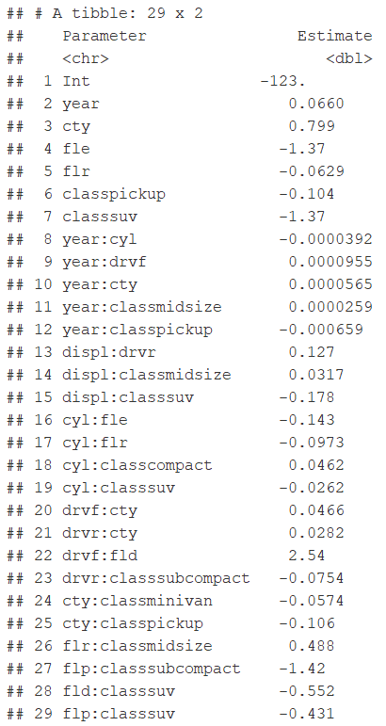
Part 3: Less Meditation and More Application
Run Chunk 3
Next
Use Best Alpha and Lambda
Observe the Non-Zero Coefficients
Plot Predictions and Errors
Table of Non-Zero
Coefficients
Before p=115
Now p=28

Slide 14
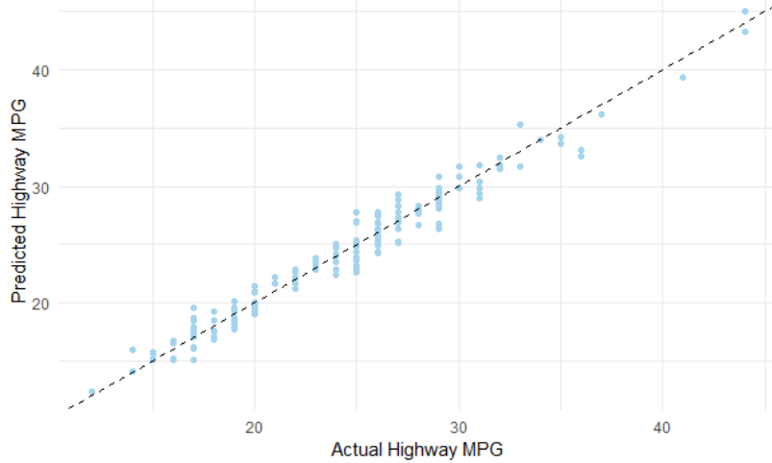
Part 3: Less Meditation and More Application
Chunk 3 (Continued)
Comparing Predict and Actual

Slide 15
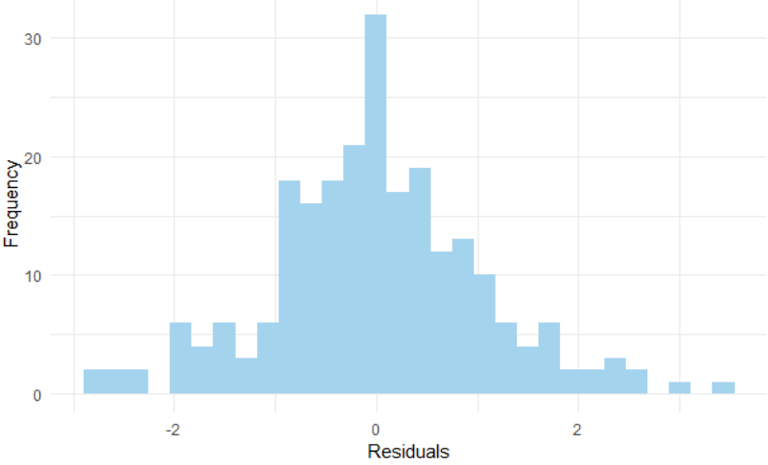
Part 3: Less Meditation and More Application
Chunk 3 (Continued)
Distribution of Residuals

Slide 16
Part 3: Less Meditation and More Application
Ecdat Data
Labor Market Participation of Married Women in Switzerland
Data From 1981
872 Married Women
Variables
Participation (Binary)
Non-Labor Income (log transformed)
Age (Scaled by 10)
Education (Years)
# of Young Children
# of Older Children
Foreigner (Binary)
> Participation

Slide 17
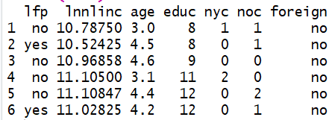
Part 3: Less Meditation and More Application
Run Chunk 4
Observe the Data
We Would Like to Build a Model to Predict Labor Involvement
Method: Logistic Regression

Slide 18
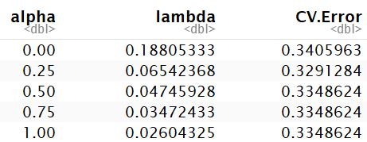
Part 3: Less Meditation and More Application
Run Chunk 5
Only a Few Options
Notice Using Binomial Family
What is the Purpose of the Following?
Lowest Estimation of Prediction Error
type.measure="class"

Slide 19
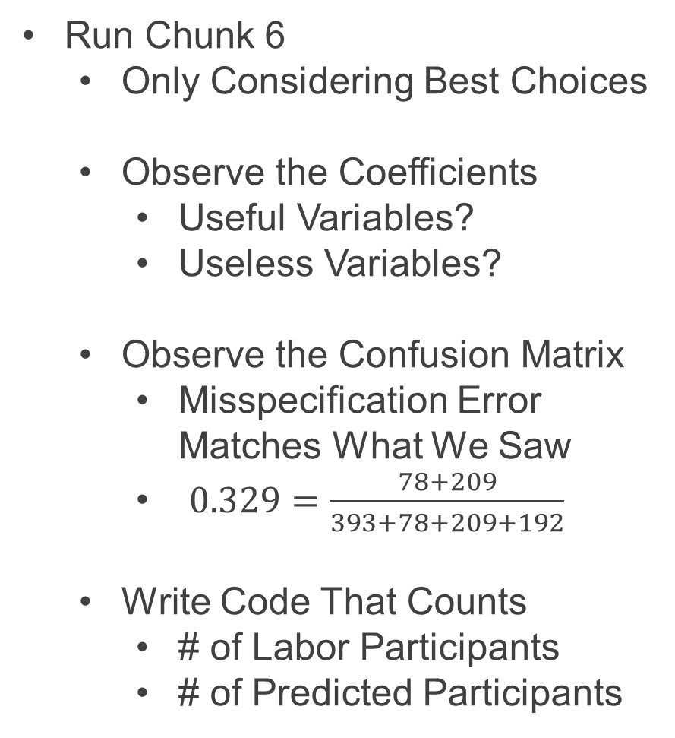
Part 3: Less Meditation and More Application
Run Chunk 6
Only Considering Best Choices
Observe the Coefficients
Useful Variables?
Useless Variables?
Observe the Confusion Matrix
Misspecification Error Matches What We Saw
$0.329=\frac{78+209}{393+78+209+192}$
Write Code That Counts
# of Labor Participants
# of Predicted Participants

Slide 20
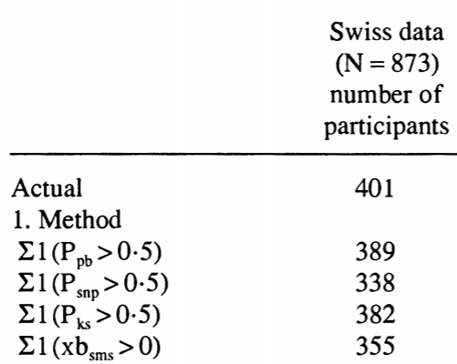
Part 3: Less Meditation and More Application
Results from Paper
Compares In-Sample Prediction of Four Competing Models
True # of Participants
Predicted # of Participants

Slide 21
Closing
Disperse and Make Reasonable Decisions

